Slide 1

SW-Engineering
‘Seotda’ Game Project
2025.06.10
B989035 이성진 | | |

Slide 2
Hongik University
CONTENTS OF TABLE
1
Domain Analysis
5
Implementation
2
Definition of Requirement
6
Testing
3
Analysis
7
Conclusion
4
Design

Slide 3
00. Domain Analysis
Hongik University
Motivation and Business Goal
1. Motivation
Cultural Motivation: Seotda is a traditional Korean folk card game that has been enjoyed by Koreans for generations. By digitizing the game, it can be made easily accessible to younger generations and international users, helping to preserve this gradually fading tradition and allowing it to evolve and be passed down in a new form.
Social Motivation: Digitizing Seotda removes the limitations of physical distance, age, or nationality, enabling people to enjoy the game together regardless of their backgrounds. It can foster intergenerational communication and cultural exchange, and also serves as a meaningful way to promote the uniqueness and charm of Korean traditional culture to a global audience.

Slide 4
00. Domain Analysis
Hongik University
Motivation and Business Goal
2. Business Goals
To transform the traditional Korean card game Seotda into a digital service that anyone can easily play in an online environment. This will allow younger generations and foreigners to experience traditional games and help preserve Korean cultural heritage by making it accessible anytime, anywhere without physical limitations.

Slide 5
00. Domain Analysis
Hongik University
‘Seotda’ Rule
Seotda Rules In Seotda, a total of 40 cards are used, with four cards for each month from January to October. Among them, one special “Gwang” (光) card is included in the sets for January, March, and August. There are also eight “Yulgeut” cards, which feature animal illustrations. As a result, the full deck consists of 29 regular cards, 8 Yulgeut cards, and 3 Gwang cards.
Jokbo (Card Combinations) Seotda uses a set of ranked combinations, called 족보 (Jokbo), which determine the outcome of a round. The standard Jokbo rankings are as follows:

Slide 6
00. Domain Analysis
Hongik University
‘Seotda’ Rule
패 | 설명
38광땡 | Combination of the March Gwang and August Gwang cards
18광땡 | January (1월) Gwang + August (8월) Gwang
13광땡 | January (1월) Gwang + March (3월) Gwang
땡 | A pair of cards from the same month (e.g., February (2월) + February (2월), …, October (10월) + October (10월)), with 장땡 (October + October) being the highest.
알리 | January (1월) + February (2월)
독사 | January (1월) + April (4월)
구삥: | January (1월) + September (9월)

Slide 7
00. Domain Analysis
Hongik University
‘Seotda’ Rule
패 | 설명
장삥 | January (1월) + October (10월)
장사 | April (4월) + October (10월)
세륙 | April (4월) + June (6월
갑오 | When the sum of the card values ends in 9 (e.g., 4 + 5)
n끗 | When the sum of the card values ends in n (e.g., 3 + 4 = 7끗)
망통 | When the sum of the card values is 10, resulting in 0끗

Slide 8
00. Domain Analysis
Hongik University
‘Seotda’ Rule
Special Combination
패 | 설명
땡잡이 | March (3월) Gwang + July (7월) face card (열끗), can nullify a regular 땡.
구사 | April (4월) + September (9월), only valid if both are not face cards.
멍텅구리 구사 | April (4월) face card + September (9월) face card.
암행어사 | April (4월) face card + July (7월) face card; this is the only combination that can defeat 18광땡 and 38광땡.

Slide 9
01. Definition of Requirements Specifications
Hongik University
Client Functional Requirement
Client requirement :
The rules of the Seotda game must be properly followed.
Each player must play at least 10 games.
The results of the games must be continuously stored in the database.
The final drawn numbers must be comparable with the 10 numbers.
Functional methods using randomization must be implemented without duplication across 6 different random functions.
Many people should be able to receive numbers together.

Slide 10
01. Definition of Requirements Specifications
Hongik University
Functional Requirement specifications
1. Game start & users
Multiple players can play the game in a single room, with a maximum limit of 4 players per room.
The host can create a room to play the Seotda game (a unique room_id will be generated).
Players can join the game by entering the room_id shared by the host.
Before the game starts, players can click the "Ready" button to indicate they are prepared.
Once all players are in the ready state, the host can start the game by pressing the "Start" button.

Slide 11
01. Definition of Requirements Specifications
Hongik University
Functional Requirement specifications
2. Card Distribution and Checking the rank
When the game starts, the deck is initialized and shuffled into a random order.
Then, each player is dealt two cards one at a time from the top of the shuffled deck, completing their hand with two cards.

Slide 12
01. Definition of Requirements Specifications
Hongik University
Functional Requirement specifications
3. Score Calculation and Winner Determination
Each player's score is calculated based on the hand rankings.
If a hand with a special rule appears, the score is adjusted or a rematch is declared according to the rule defined in the hand ranking.
In the event of a tie, only the tied players will participate in a separate rematch.
The player who reaches the most victories first across 10 rounds becomes the final winner, and the game ends at that point.
After the game ends, if all players agree to a rematch, a new game can be started.

Slide 13
01. Definition of Requirements Specifications
Hongik University
Functional Requirement specifications
4. Game Records and Storage
Each game result (date, winner, hand, and stakes) is stored in the database and can be viewed at any time on the user's profile page.
5. Game Conclusion and Statistics Display
After a certain number of games, overall statistics (such as win rate by player, most frequent winning hand, etc.) are displayed.

Slide 14
01. Definition of Requirements Specifications
Hongik University
Client Non-Functional Requirement
Client Non-Functional Requirements :
The UI needs to be designed.
Sound effects should be added to the game.
The game results must be monitored.
It should be possible to start a new game.

Slide 15
01. Definition of Requirements Specifications
Hongik University
Non-functional Requirement Specification
1. Performance
The server must be able to reliably handle up to 50 simultaneous game rooms, each with a maximum of 4 players.
Core game operations such as card shuffling, hand distribution, score calculation, and hand evaluation must be completed within one second during gameplay.
Retrieving game records and statistics from the database should respond without delay.

Slide 16
01. Definition of Requirements Specifications
Hongik University
Non-functional Requirement Specification
2. Reliability & Robustness
The system must preserve or properly recover the game state in the event of network disruptions or server errors.
The process of ending the game and saving results must be guaranteed to avoid data loss or errors.
3. Scalability
Although initially designed for 4-player rooms, the system must be flexibly designed to support additional rooms or features (e.g., AI players, ranking systems) in the future.
The system should allow for modification and addition of hand rankings.

Slide 17
01. Definition of Requirements Specifications
Hongik University
Non-functional Requirement Specification
4. Ease of Use
The user interface should be intuitive and clearly explain the game rules, progress, and win conditions.
Processes such as player readiness, game start, game end, and replay selection must proceed intuitively and without confusion.
Key game events—such as card distribution, hand announcement, and winner declaration—should include sound effects to help users intuitively recognize what is happening.

Slide 18
01. Definition of Requirements Specifications
Hongik University
Non-functional Requirement Specification
5. Security
Players’ personal information, game records, and statistical data must be securely managed to prevent unauthorized access or leakage.
Unique room_ids must be securely generated and managed to prevent unauthorized or tampered access from outside.

Slide 19
01. Definition of Requirements Specifications
Hongik University
Non-functional Requirement Specification
6. Modifiability & Good Documentation
Game rules, hand rankings, and special rules should be modularized within the system to allow for easy modification and expansion.
The source code and system architecture must be well-documented to facilitate easy maintenance by developers.

Slide 20
02. Analysis
Hongik University
Definition of a System Architecture
Programming Language : Python(Backend), JavaScript(Frontend)
Framework : Fast Api(server), React(web)
DB : MariaDB
Networking Layer: WebSocket, Rest API
Frontend uses REST API to load and save core game data from the database (users, rooms, games).
Backend handles game logic via Game Room Manager, determining winners and saving results.
WebSocket enables real-time, event-driven gameplay communication (card dealing, turns).
MariaDB stores all persistent game data securely.

Slide 21
02. Analysis
Hongik University
Definition of User interface Requirements
Lobby Screen
Users can create a new room or join an existing one using a unique room_id.
A list of available rooms should be displayed with room name, current players, and game status.
Each room must clearly indicate the maximum capacity (4 players).
A toggle button for Sound On/Off should be available.

Slide 22
02. Analysis
Hongik University
Definition of User interface Requirements
Ready Screen (Pre-Game)
Upon entering a room, a list of players and their ready status (Ready / Not Ready) should be shown.
Each player can click a "Ready" button to mark themselves as prepared.
The host can click the "Start" button only when all players are marked as Ready.

Slide 23
02. Analysis
Hongik University
Definition of User interface Requirements
In-Game Screen
Display each player's nickname and two cards dealt.
A player's own cards are visible only to themselves; other players’ cards appear hidden.
At the end of each round, show hand rankings (족보) and score results clearly

Slide 24
02. Analysis
Hongik University
Definition of User interface Requirements
Game Results & Statistics
Show overall game results including:
Final winner, Win count per player, Final scores
Provide a summary of previous game logs:
Round-by-round hand rankings, Round winners
Include a "Rematch Request" button with visible agreement status from all players.

Slide 25
02. Analysis
Hongik University
Definition of User interface Requirements
User Profile / My Page
Users can access personal game statistics on the main screen or in “My Page”:
Total games played & wins
Win rate = (wins / total games)
Most frequent winning hand (족보)
Recent game history (last 5 games)

Slide 26
02. Analysis
Hongik University
Definition DB Requirements
DB Requirements Overview
Each user must have a unique ID and a non-duplicate nickname (username), which can be used as an identifier during login and gameplay participation.
User information should be usable for game statistics, record lookup, and win rate calculations.
Room Management
Every room must have a unique ID, and its status must be categorized as either waiting, playing, or deleted.
The room’s creation time should be recorded in the created_at field, and each room must allow up to 4 players.

Slide 27
02. Analysis
Hongik University
Definition DB Requirements
Game Management
Each game must have a unique ID and must be identifiable by the room_id indicating in which room the game was played.
The start and end times of the game must be accurately recorded in the start_tm and end_tm fields, respectively.

Slide 28
02. Analysis
Hongik University
Definition DB Requirements
Room Player Management
Participants should be represented by the relationship between user_id and room_id, with each participant able to indicate readiness via the is_ready field.
The leader field must clearly indicate whether a participant is the host, and each room must be limited to a maximum of 4 players.
Duplicate participation by the same user should not be allowed. Upon room deletion or player exit, related data should either maintain integrity or be automatically removed.
This table should also be used in connection with the Gamelog table to track card distribution and win/loss outcomes.

Slide 29
02. Analysis
Hongik University
Definition DB Requirements
Game Log Management
Each game log must be identifiable by a combination of game_id and player_id, indicating the participation of a specific player in a specific game.
The log must include the player’s hand (player_hand) and a Boolean field (is_winner) indicating whether the player won the game.
A maximum of 4 records should be stored per game, and this data should be used to compute user-specific statistics such as win count, total games played, and win rate.

Slide 30
02. Analysis
Hongik University
Definition DB Requirements
DB Relationship Summary
Users ↔ RoomPlayers (1:N)
Rooms ↔ RoomPlayers (1:N)
Rooms ↔ Games (1:N)
Games ↔ Gamelog (1:N)
RoomPlayers ↔ Gamelog (1:N)

Slide 31
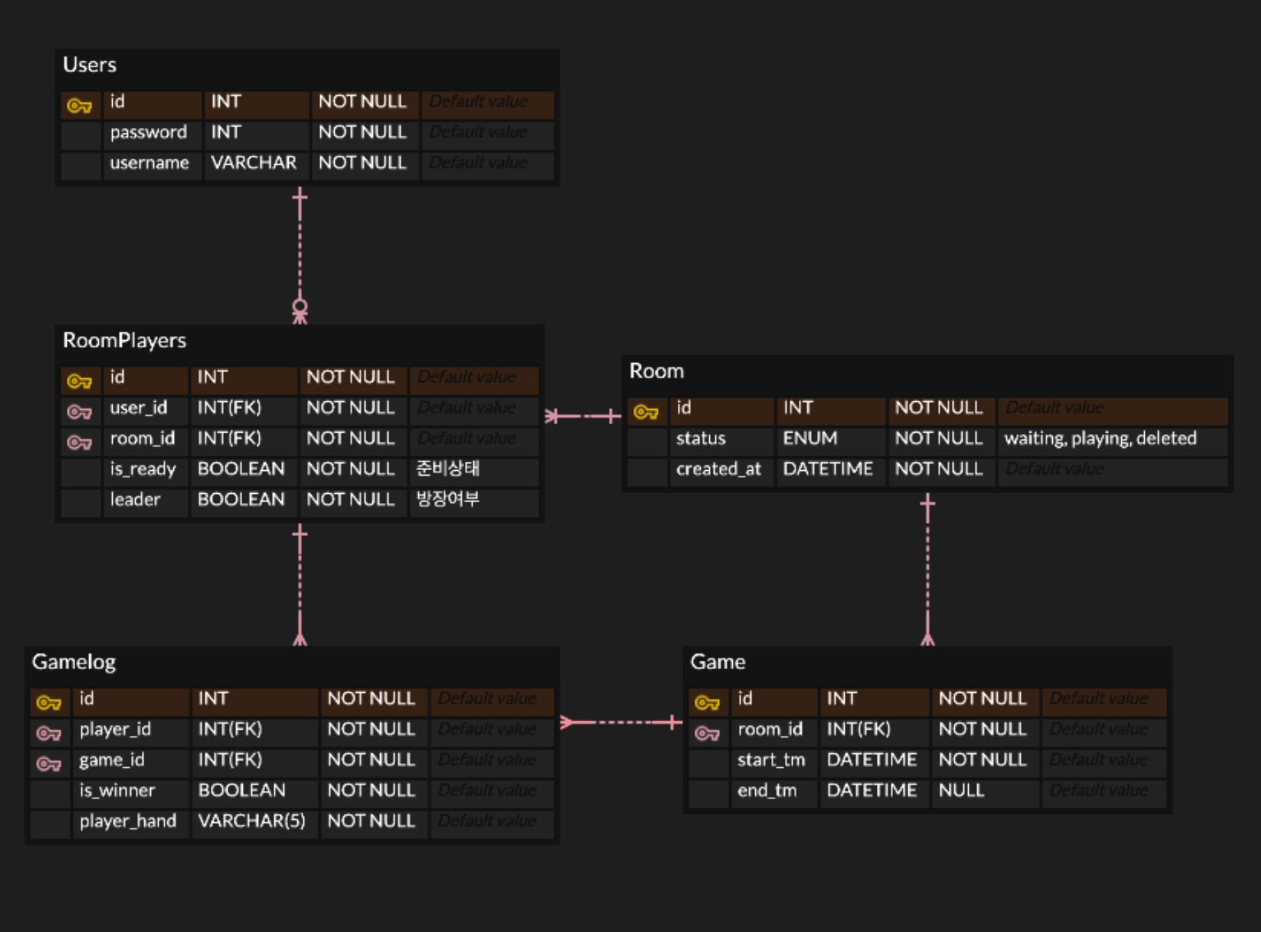
02. Analysis
Hongik University
Definition DB Requirements

Slide 32
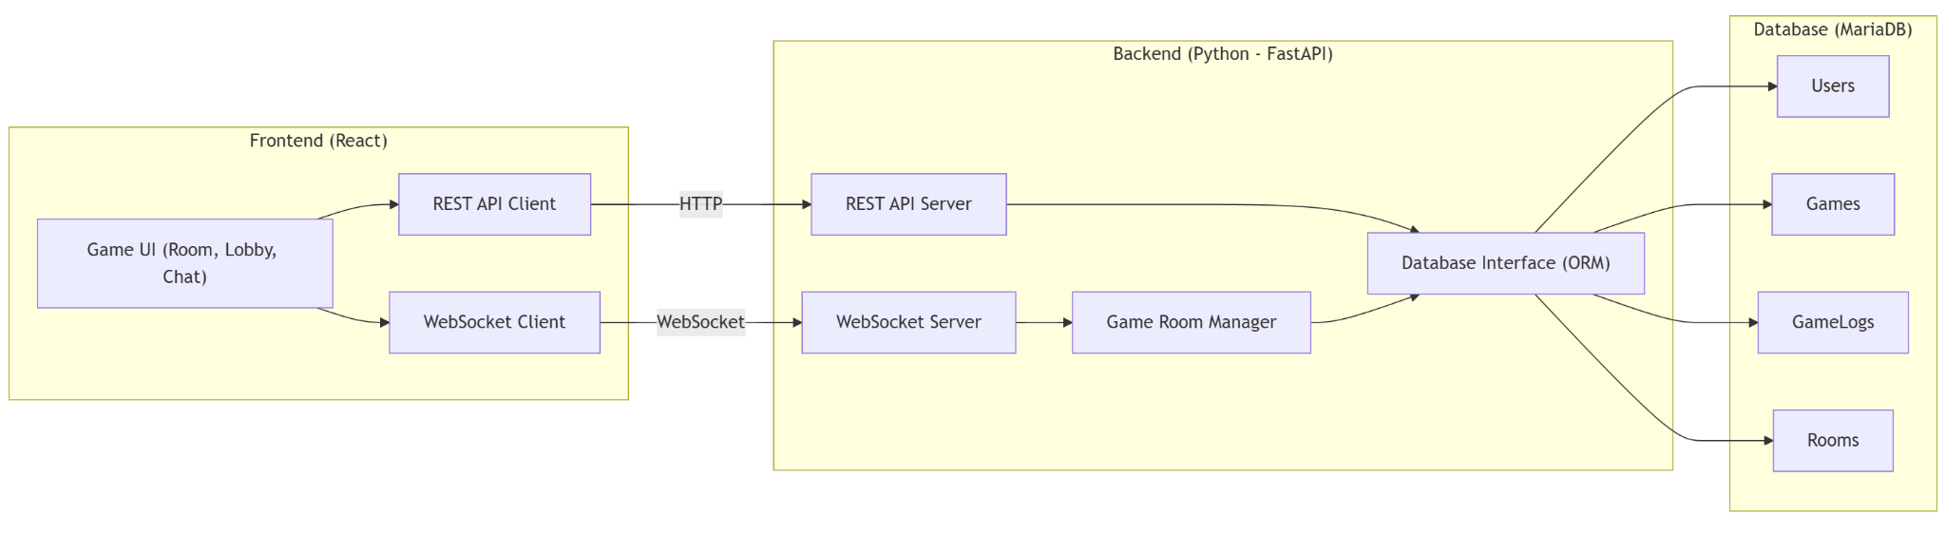
03. Design
Hongik University
System Architecture Design

Slide 33
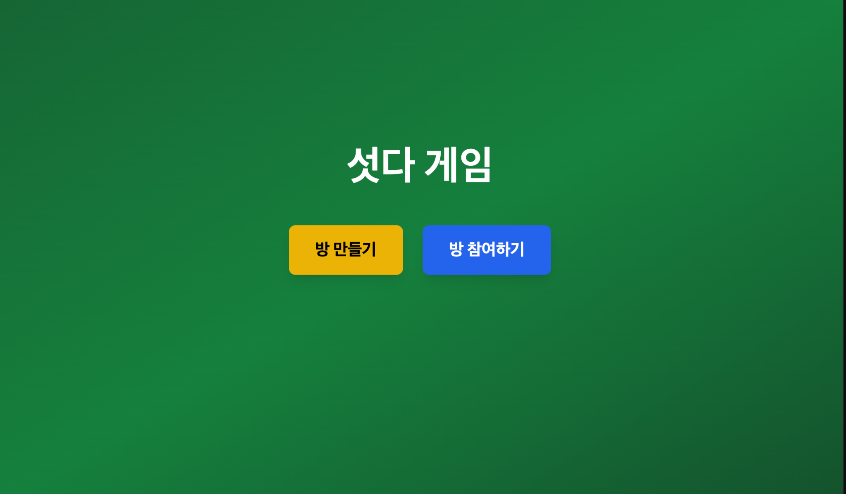
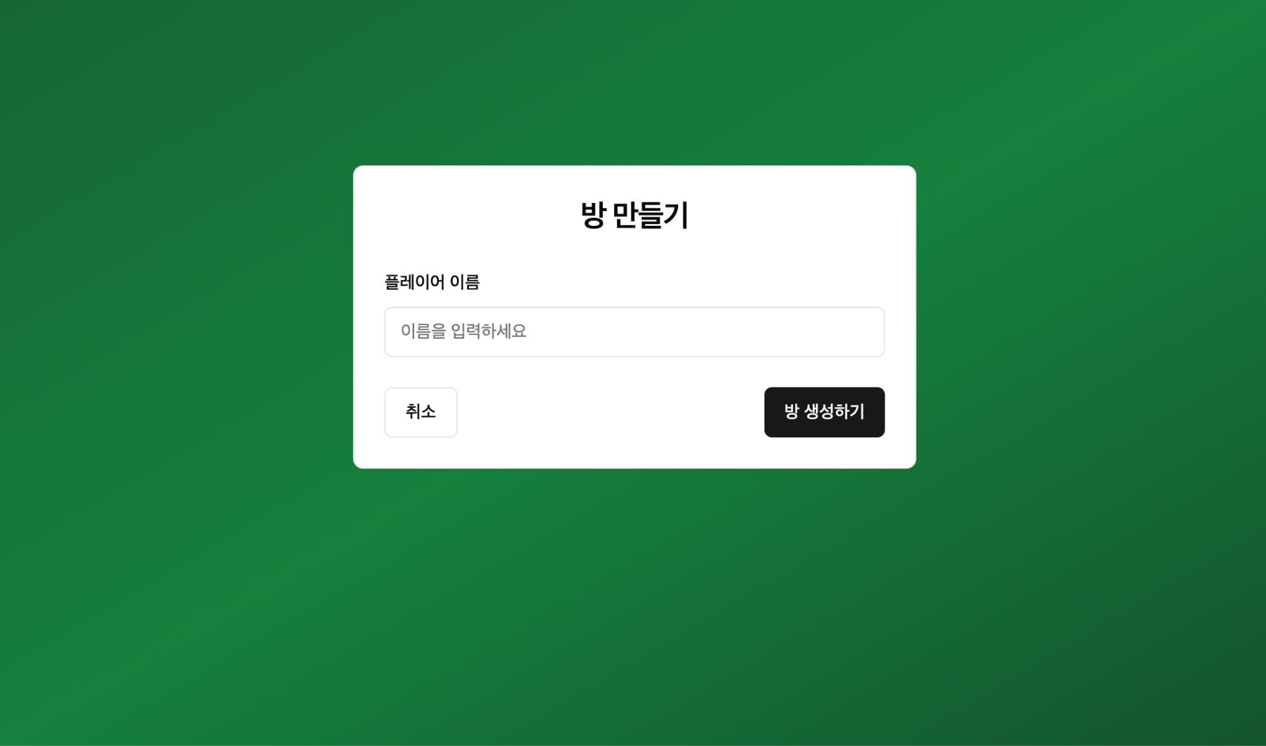
03. Design
Hongik University
Design User Interface
Main menu :
Create room :

Slide 34
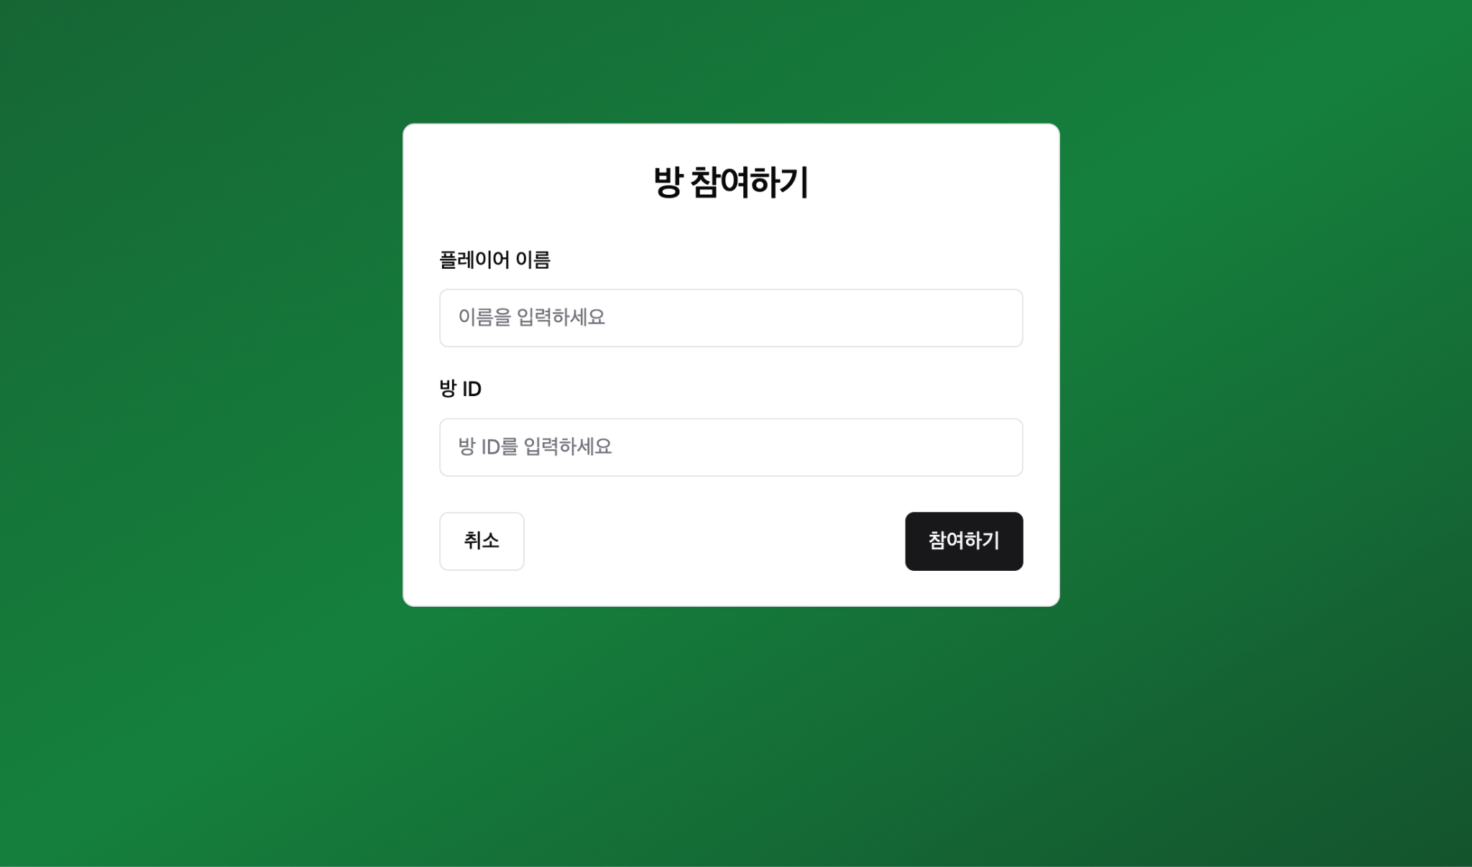
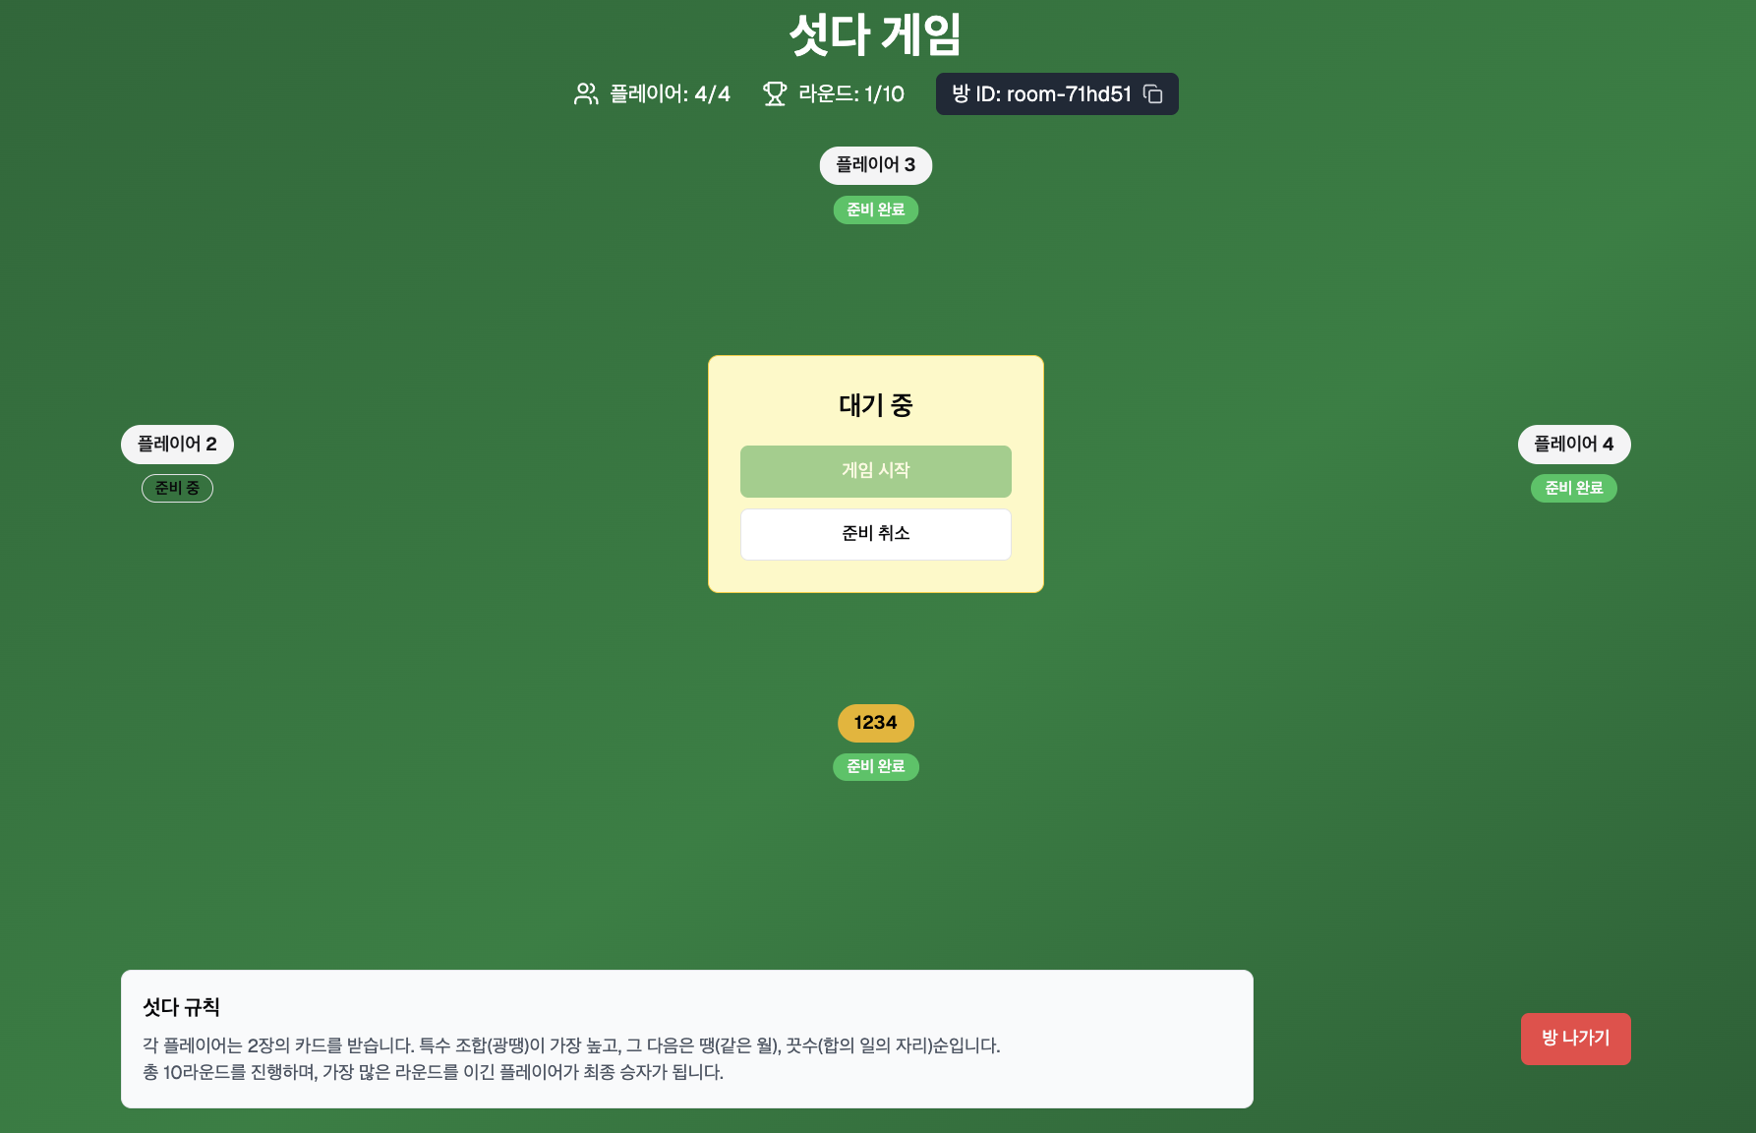
03. Design
Hongik University
Design User Interface
Participating room :
In game :

Slide 35
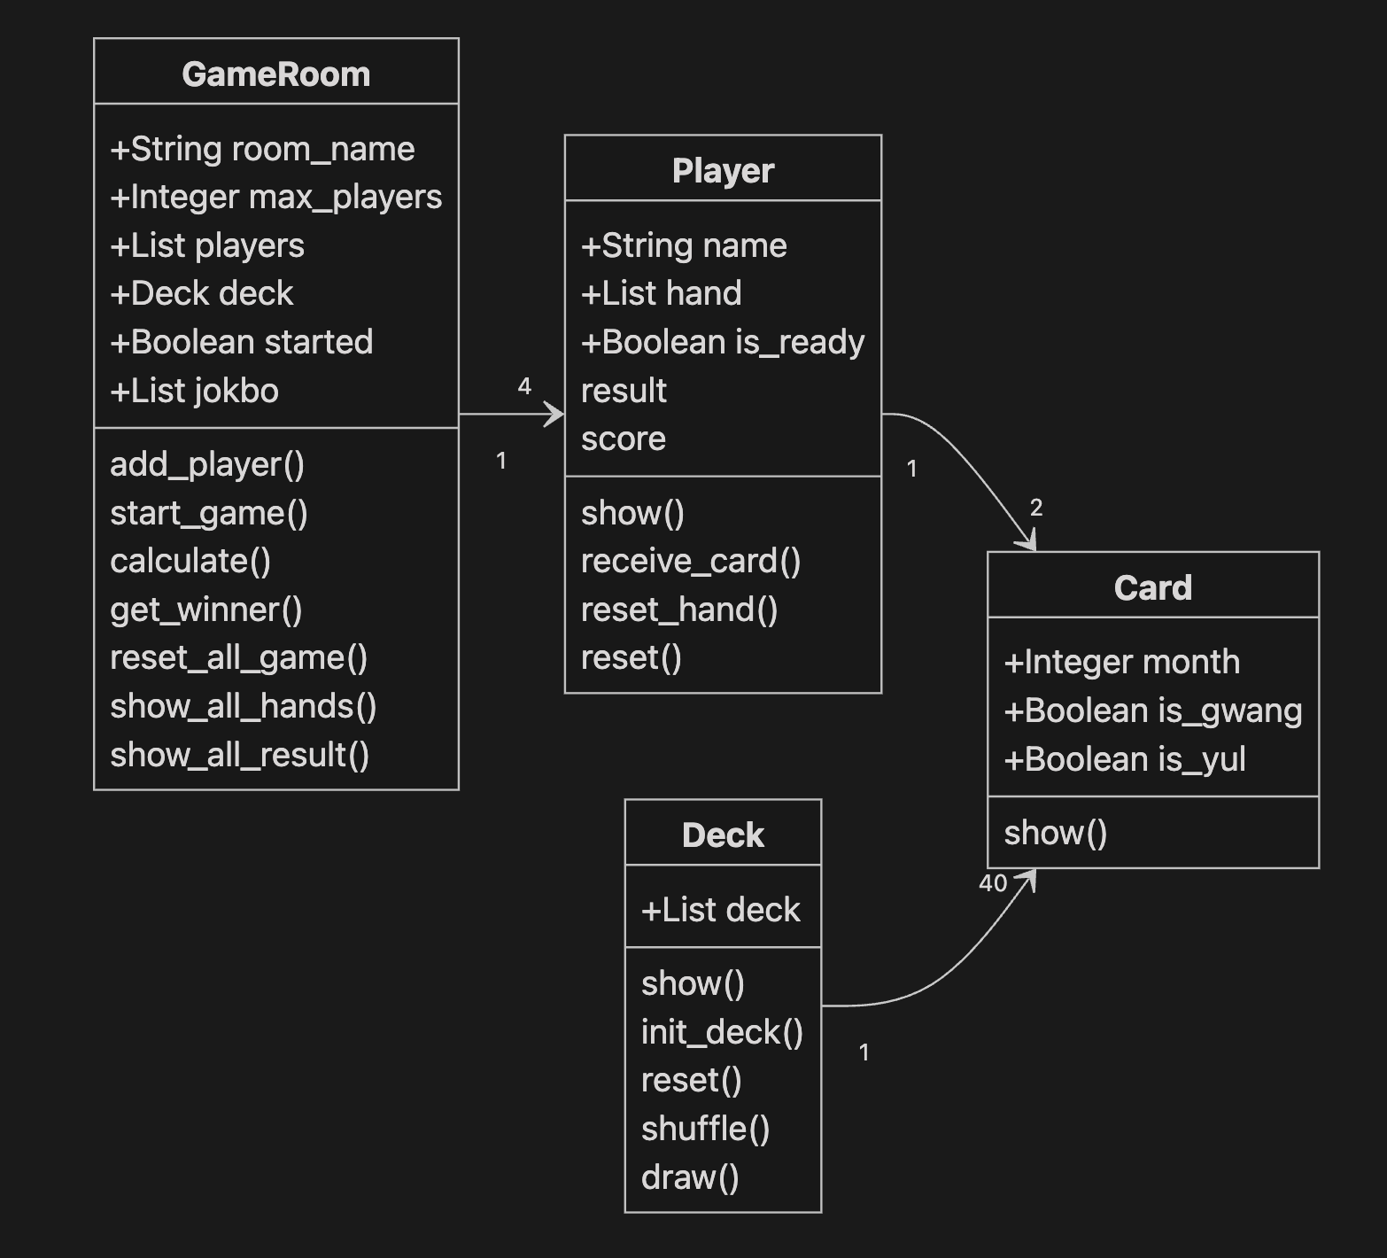
03. Design
Hongik University
Class Diagram Design

Slide 36
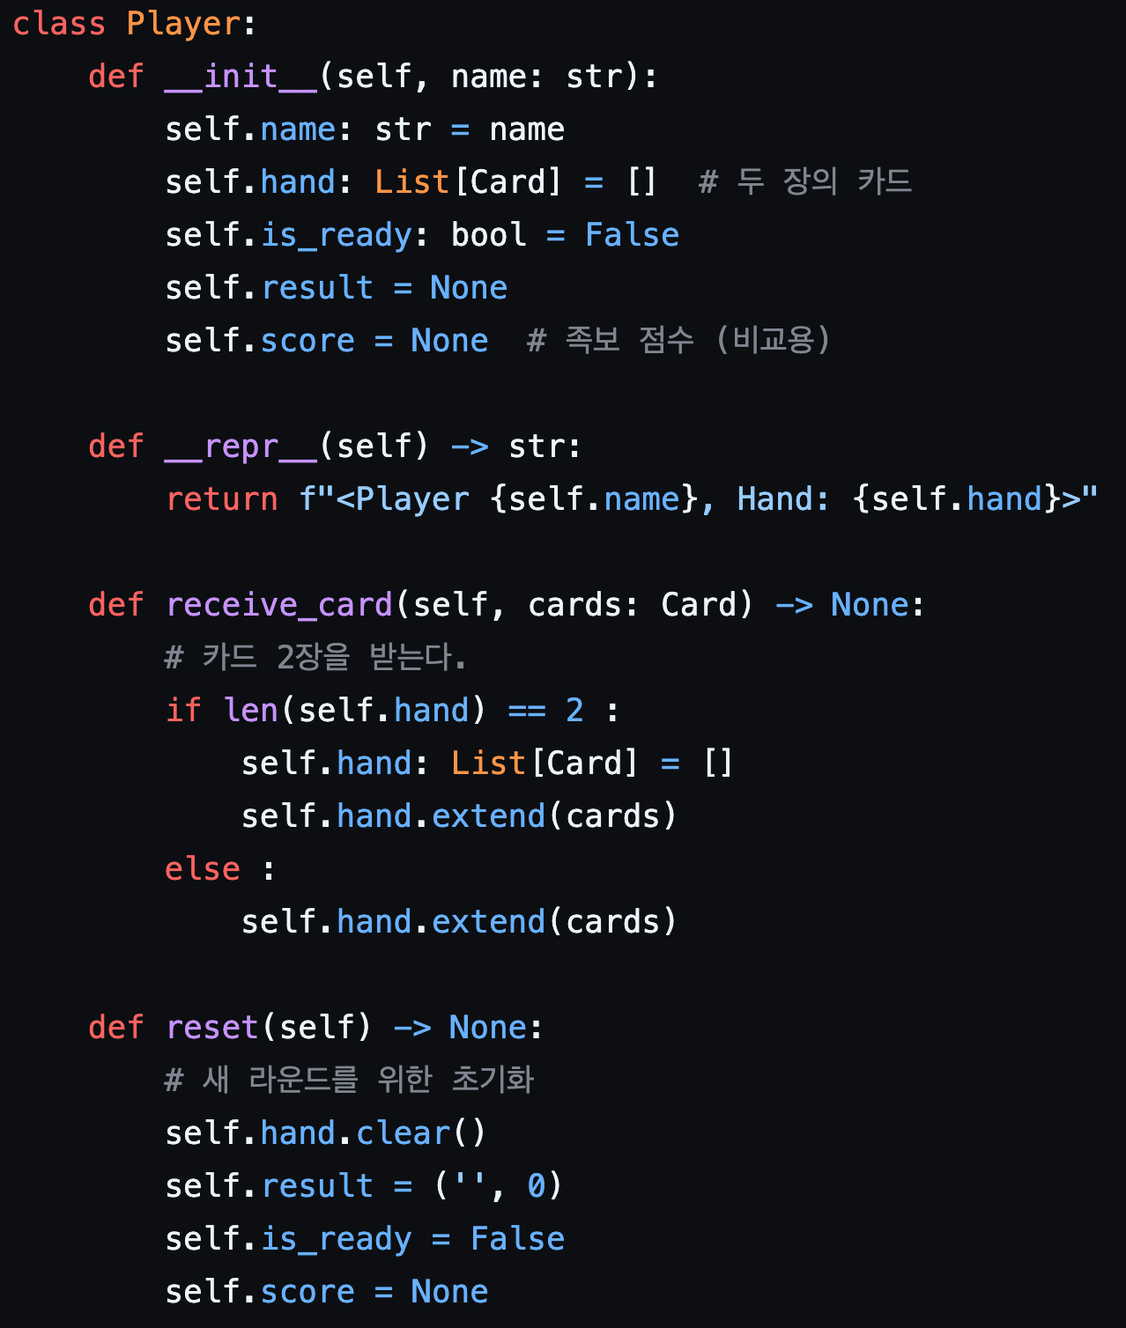
04. Implementation
Hongik University
Design User Interface

Slide 37
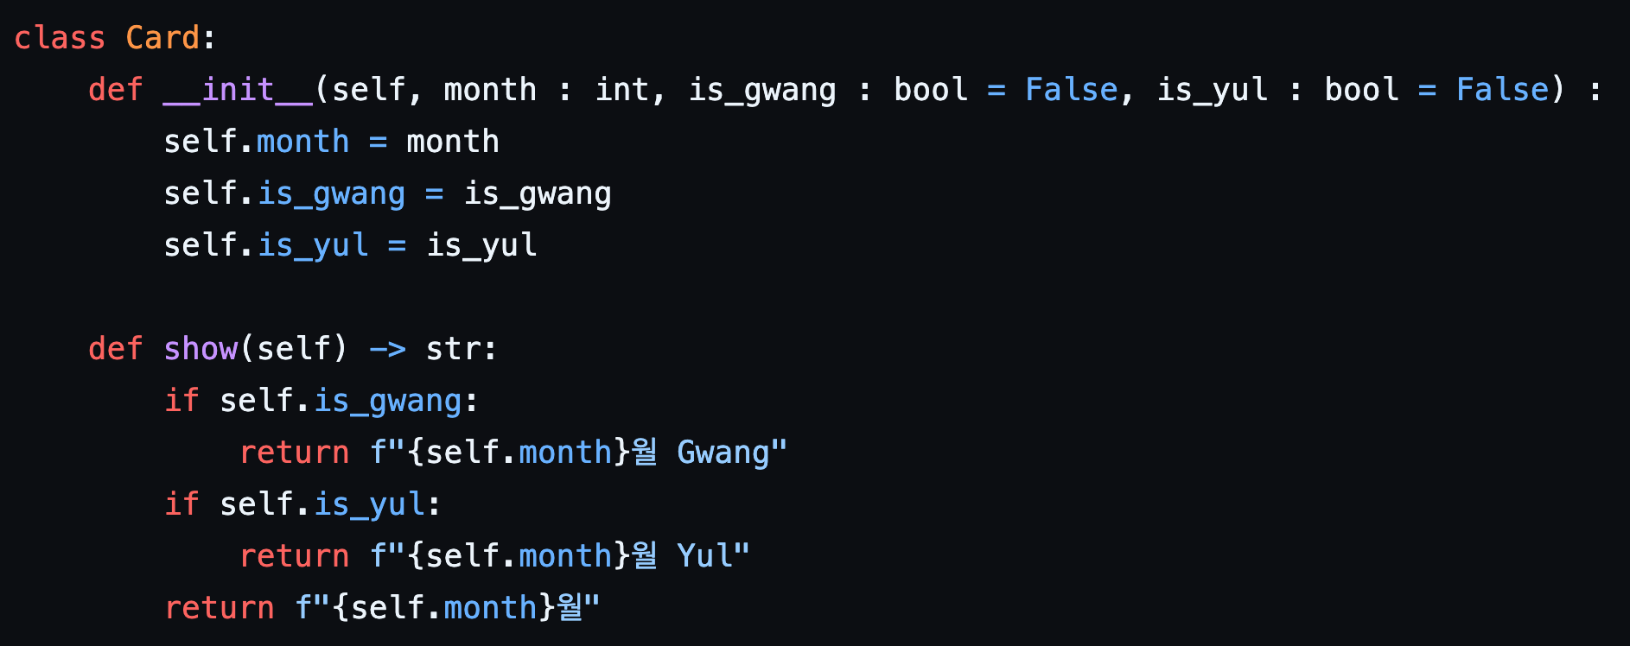
04. Implementation
Hongik University
Function code

Slide 38
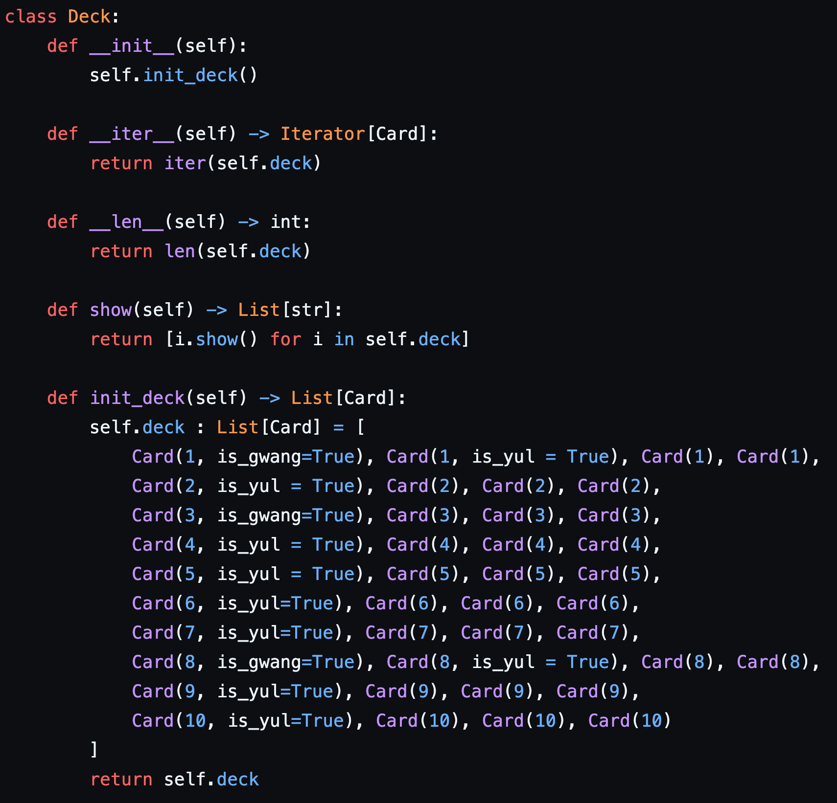
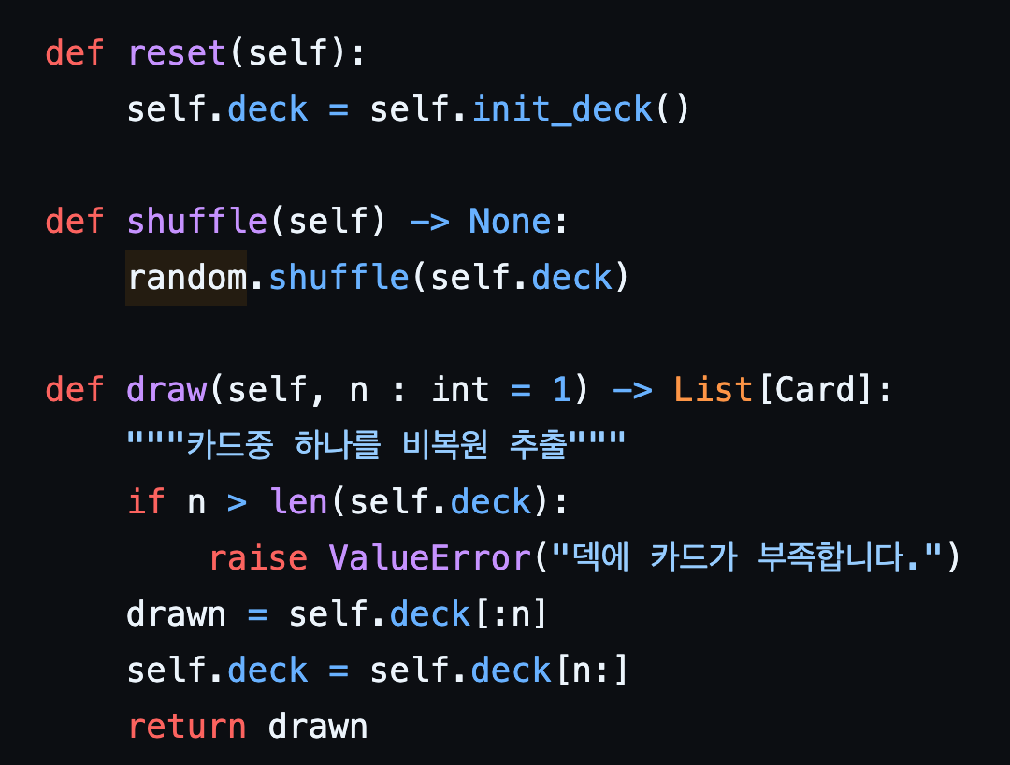
04. Implementation
Hongik University
Function code

Slide 39
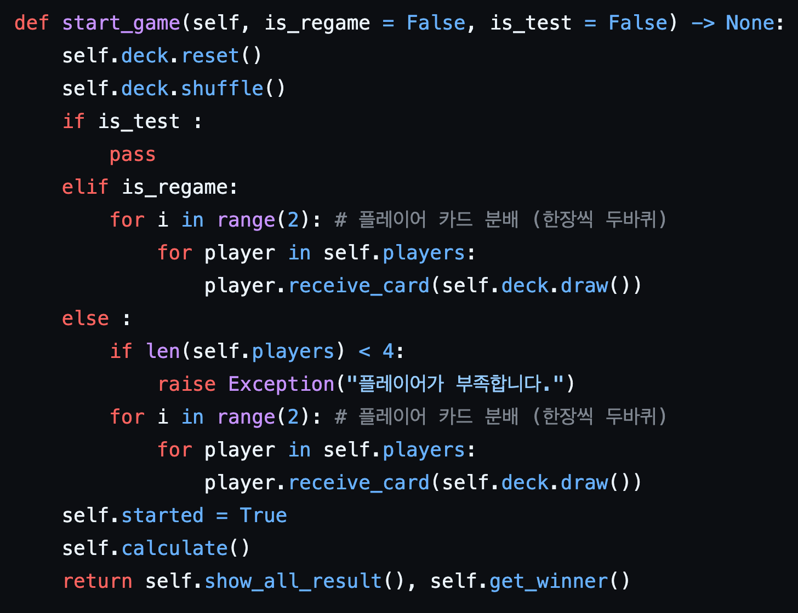
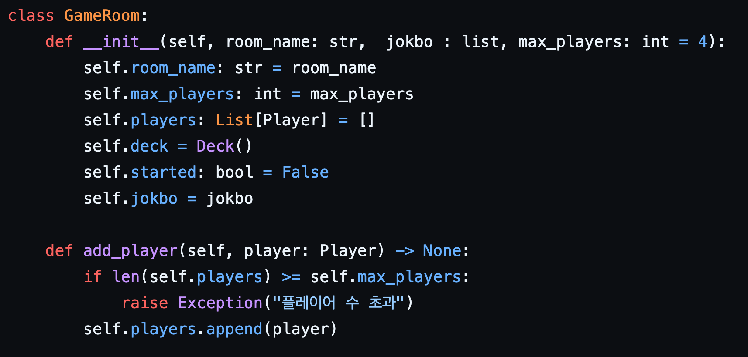
04. Implementation
Hongik University
Function code

Slide 40
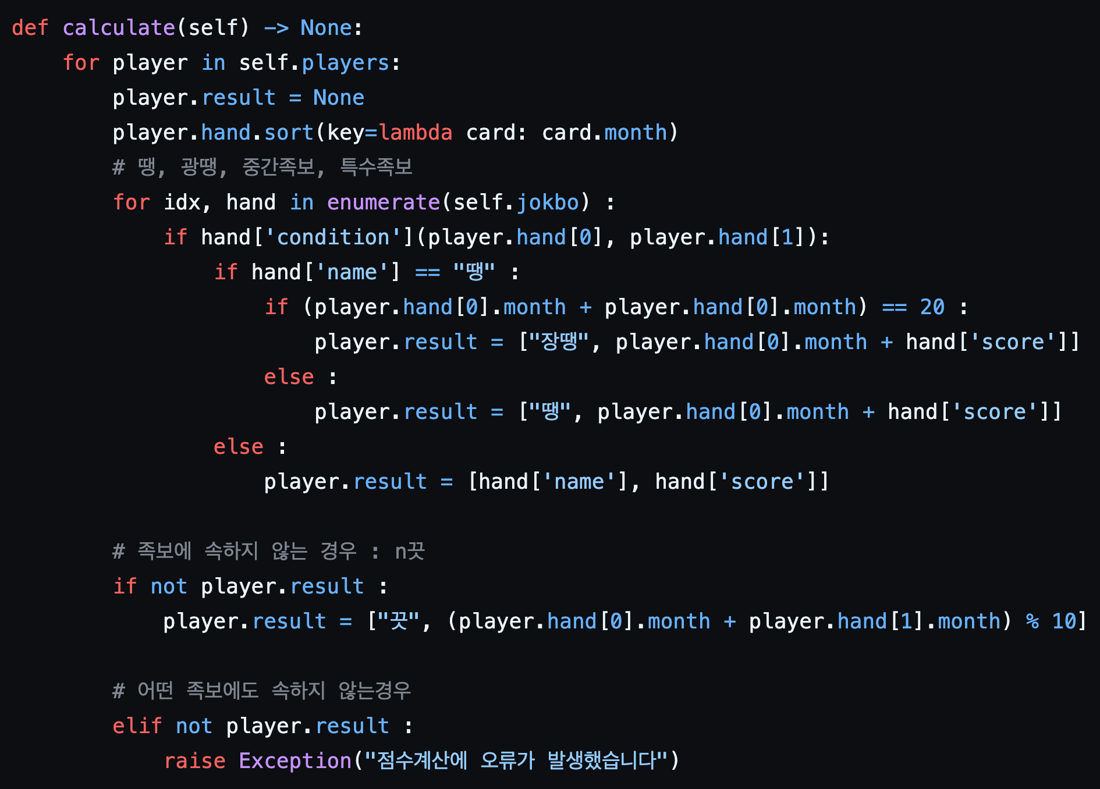
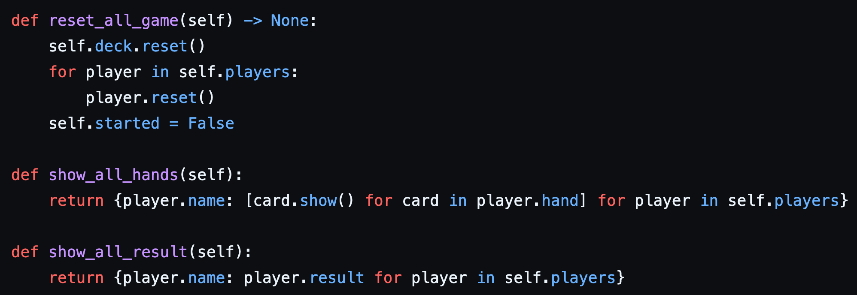
04. Implementation
Hongik University
Function code

Slide 41
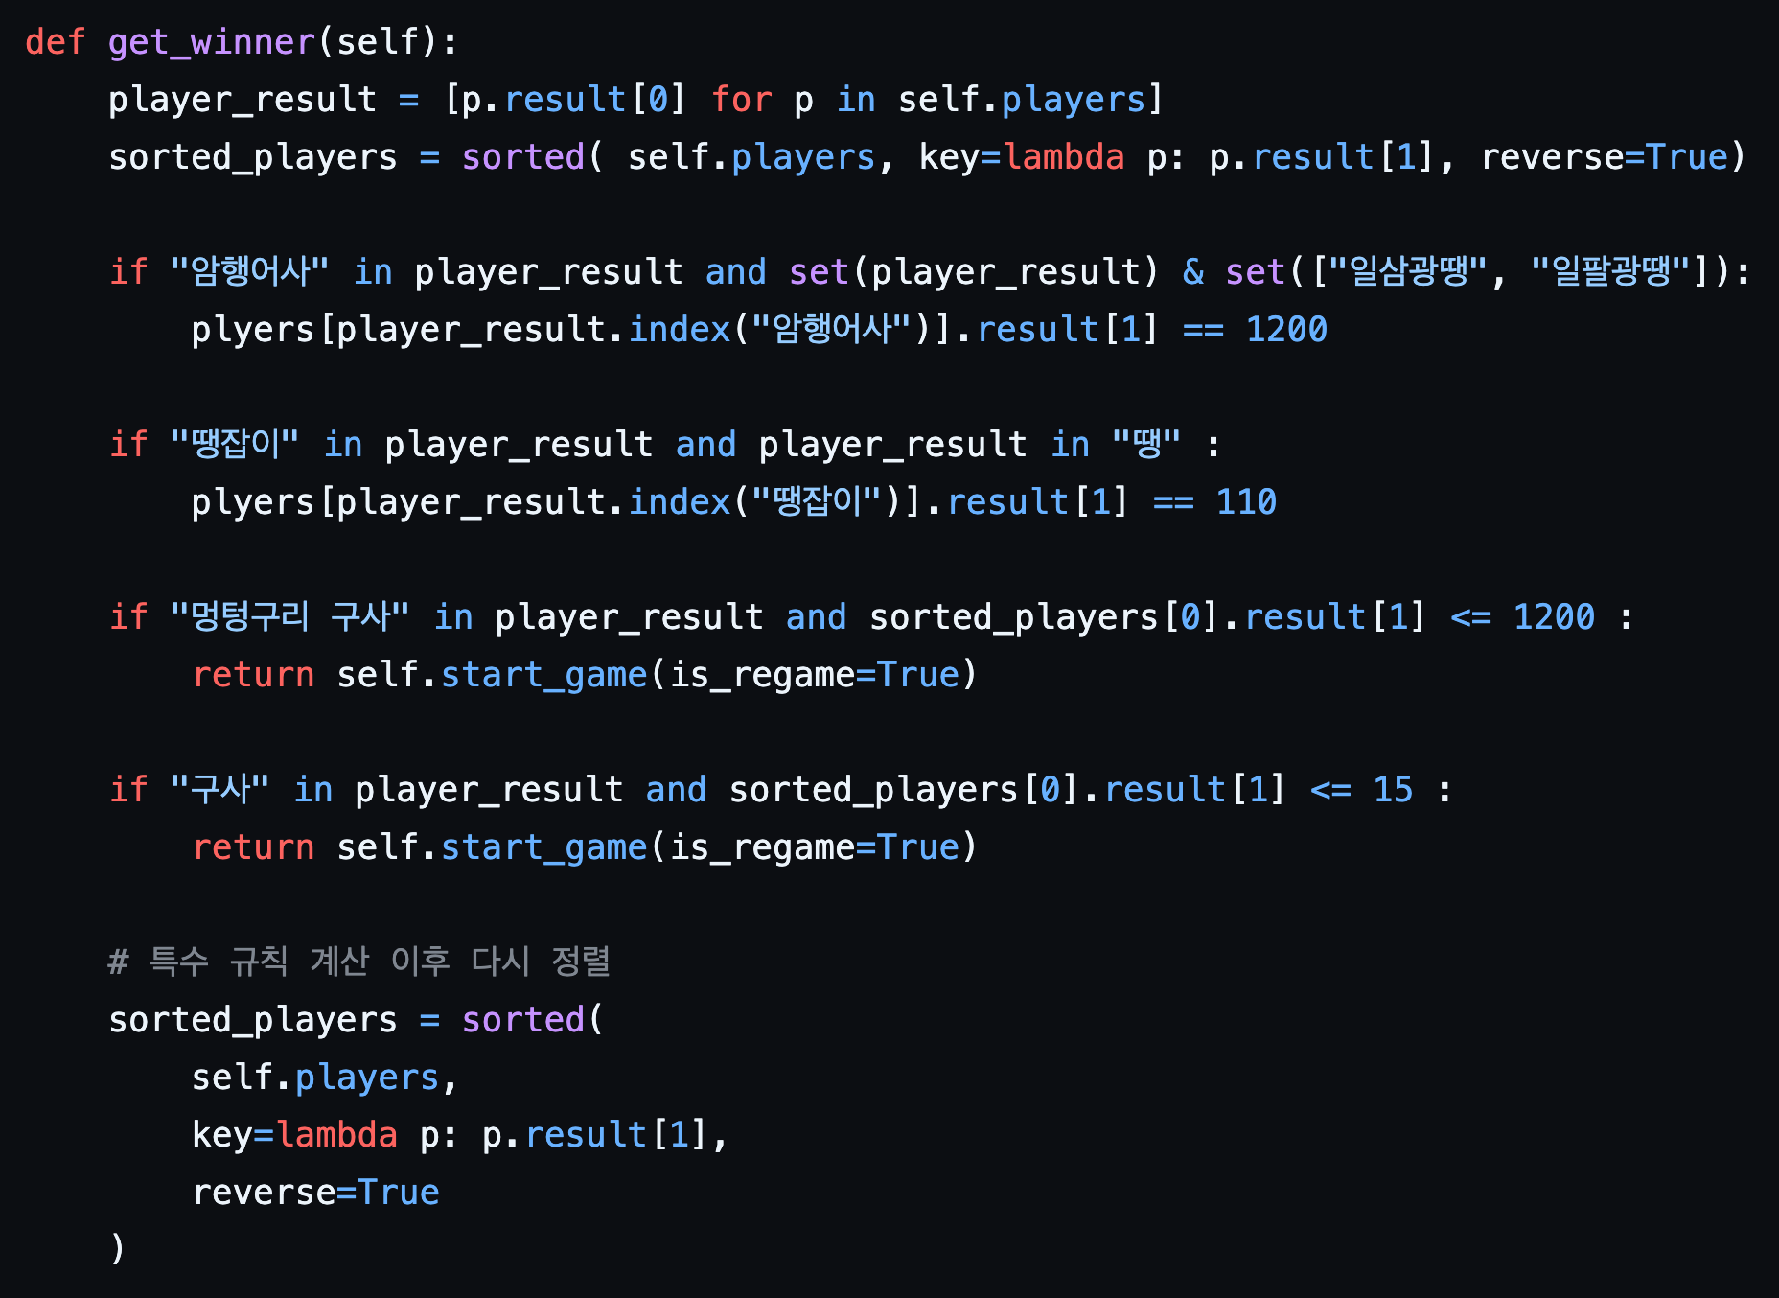
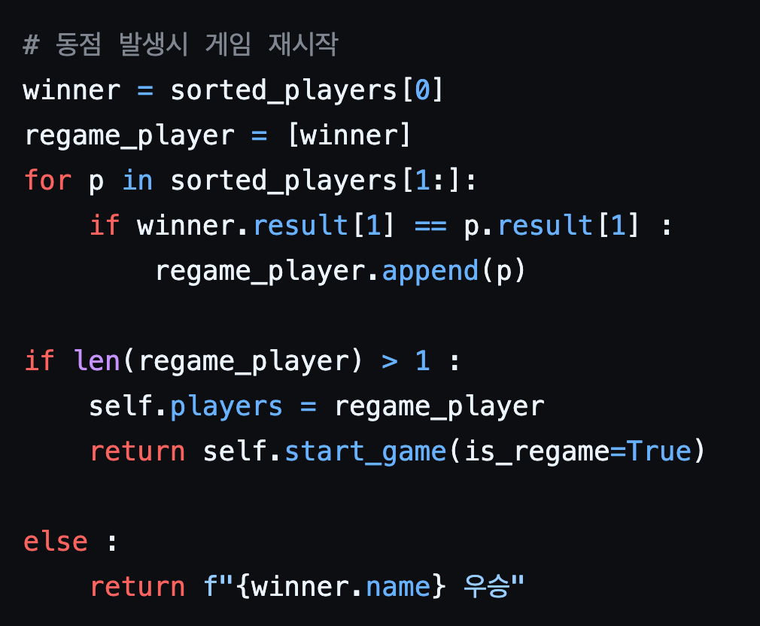
04. Implementation
Hongik University
Function code
https://github.com/software-engineering-sutda/seotda_src.git

Slide 42
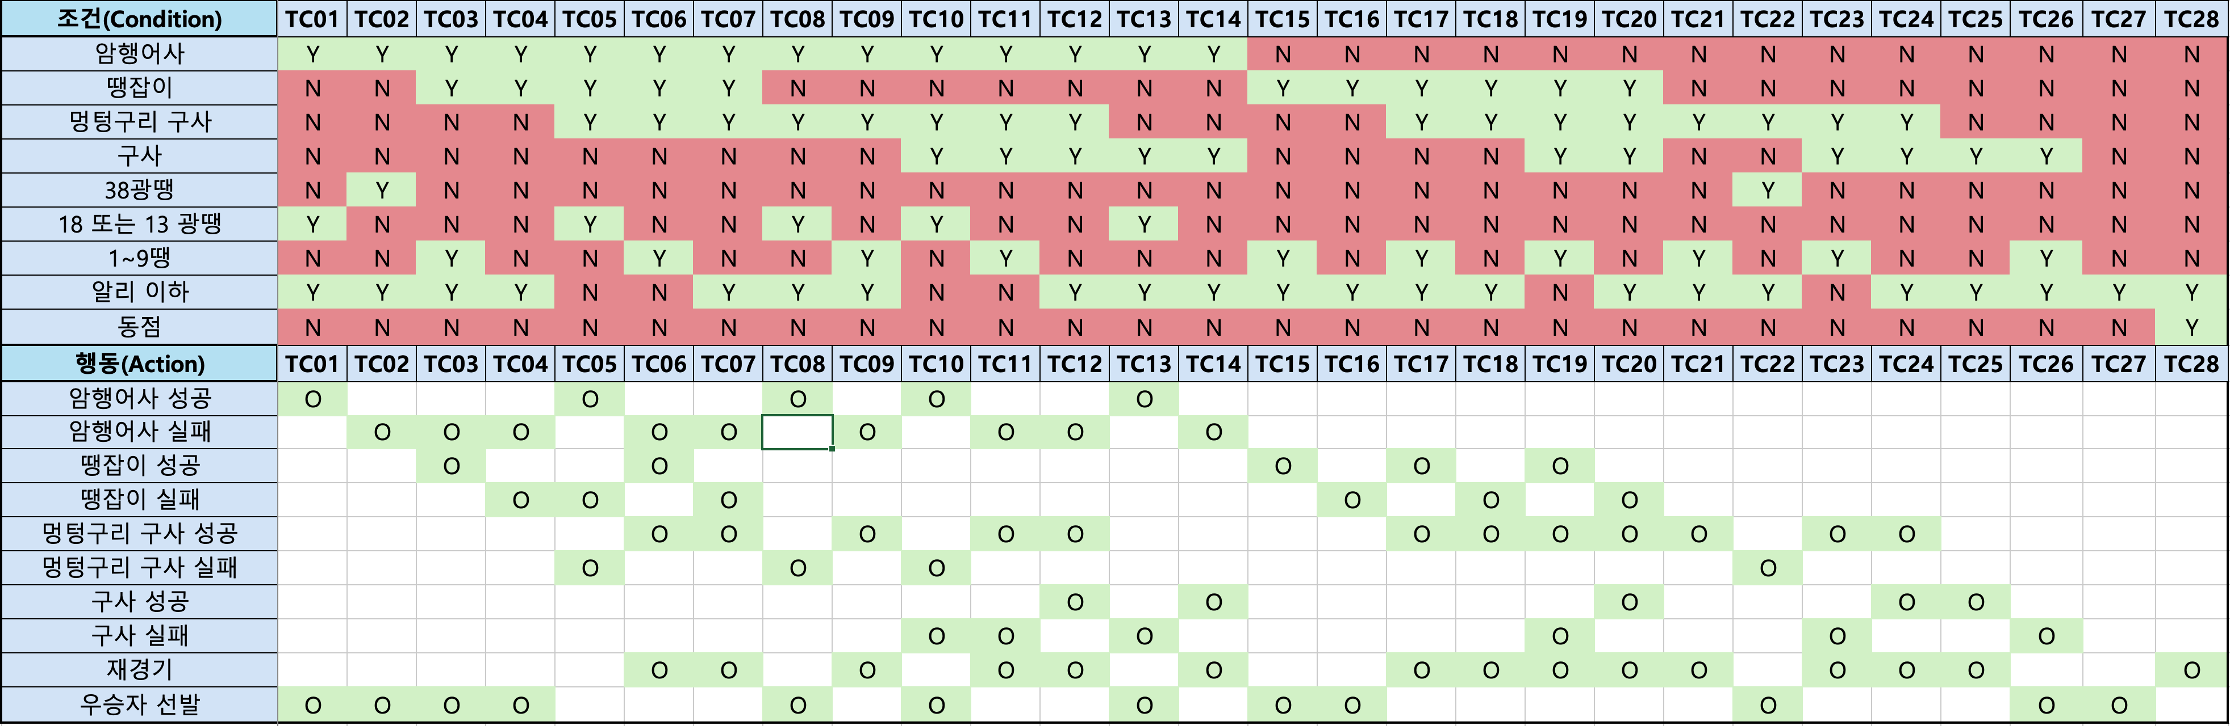
05. Testing
Hongik University
Testing
https://github.com/software-engineering-sutda/seotda_src.git

Slide 43
06. Conclusion
Hongik University
Improvements of your Developed system
Backend and Frontend Incompletion
The project lacks a fully implemented backend and frontend. Completing these would allow users to actually play the game through a functional web interface.
Game Money Betting System
Adding a virtual currency betting system could increase engagement and make the game more competitive.
Android App Expansion
Developing an Android version would enhance accessibility for mobile users.
Language Switching Feature
Supporting English and other languages would make the game more accessible to international users and promote Korean culture globally.
Notes:
유저 친화적 UI, 게임 사운드, 배팅 시스템 추가

Slide 44
06. Conclusion
Hongik University
Expected Efforts of your system
1. Preservation and Modernization of Traditional Culture
The system contributes to preserving the traditional Korean card game Seotda, which is gradually fading from modern life. By digitizing it into an accessible web-based game, the system helps modernize and globalize traditional culture, allowing younger generations and international users to easily experience Korean folk games.
2. Enhancing Intergenerational and Cross-Cultural Communication
The game allows players of all ages and backgrounds to interact and play together without physical or cultural barriers.
This promotes intergenerational communication and serves as a cultural bridge between Korean and global communities through engaging gameplay.
3. Scalable and Maintainable Design Foundation
The system is designed with modularity and scalability in mind, allowing for future extensions such as AI opponents, ranking systems, or login features.

